Slide 1
NameCheap Hosting
Lecturer: Ngo Huy Bien
Software Engineering Department
Faculty of Information Technology
University of Science
Ho Chi Minh City, Vietnam
nhbien@fit.hcmus.edu.vn

Slide 2

Objectives
To create and configure a website using NameCheap hosting.

Slide 3

Contents

Slide 4

References

Slide 5
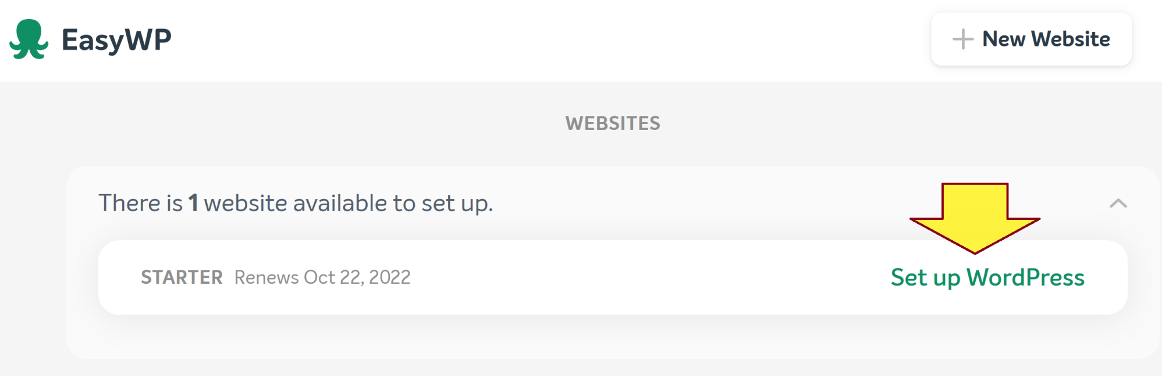
1. Set up WordPress Website
https://dashboard.easywp.com/

Slide 6
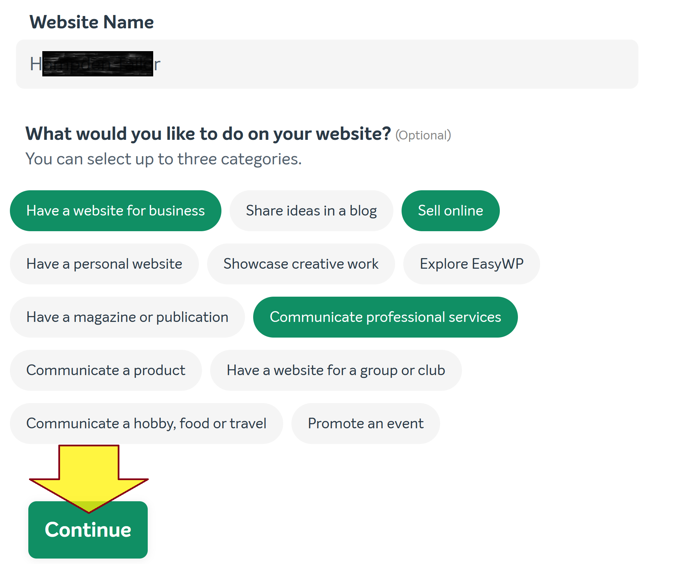
2. Enter Website Name

Slide 7
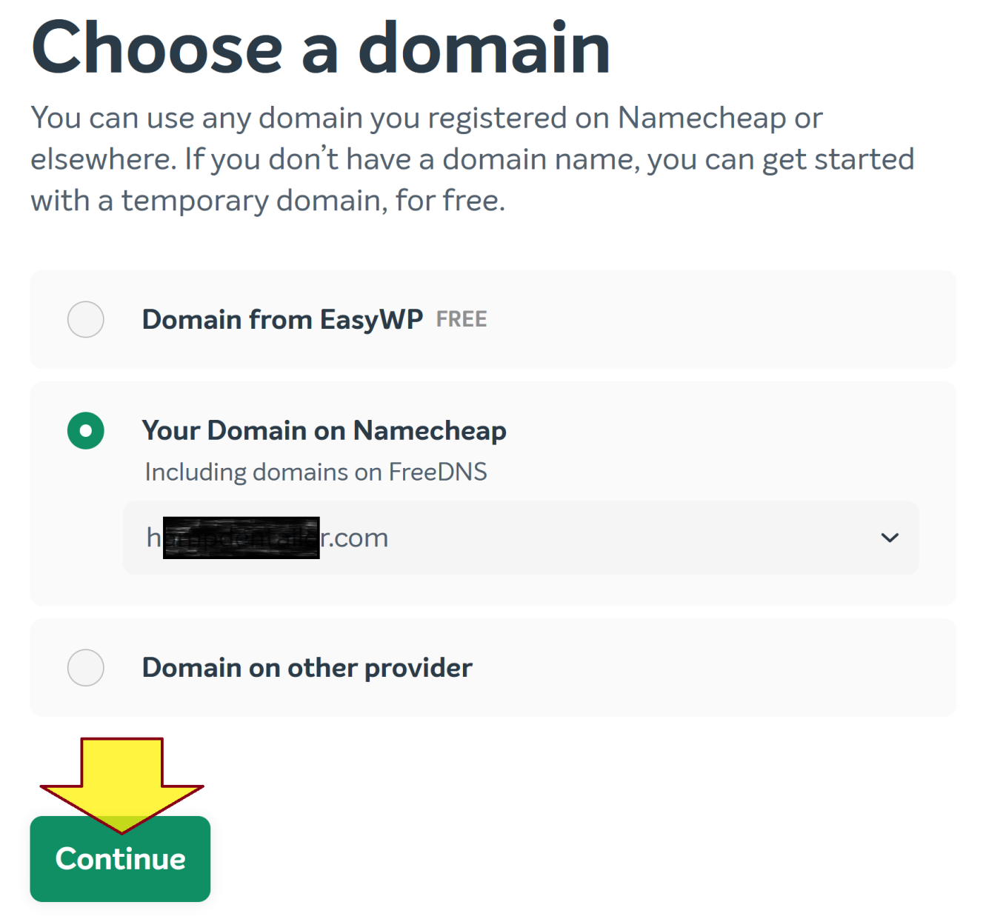
3. Choose a Domain

Slide 8
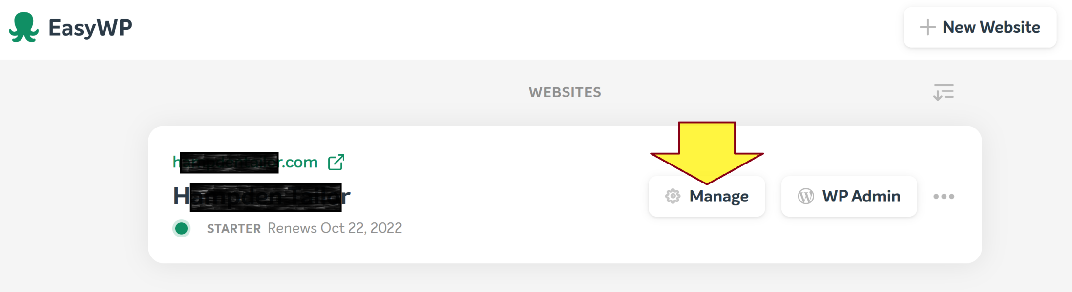
4. Manage the Website

Slide 9
This page intentionally left blank.

Slide 10
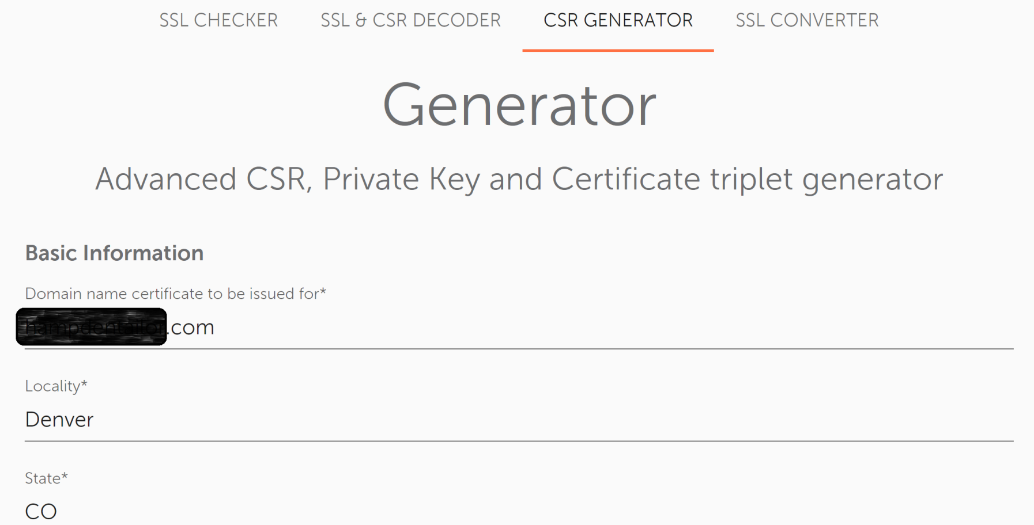
1. Generate a CSR File for NameCheap
https://decoder.link/csr_generator/

Slide 11
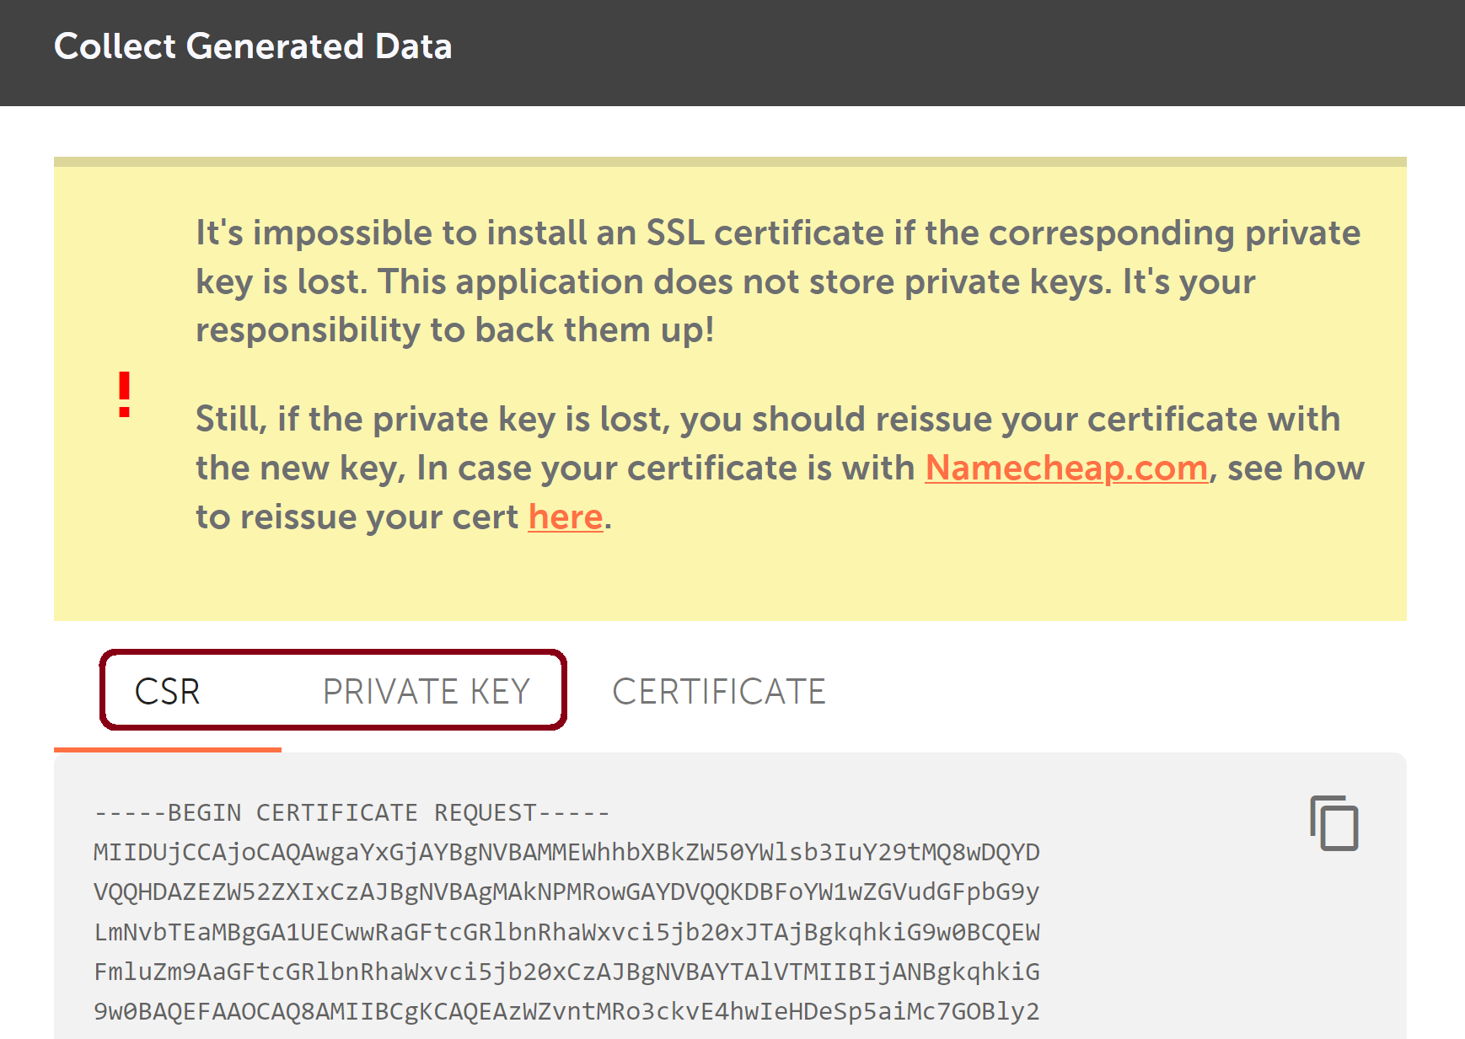
2. Collect Generated Data

Slide 12
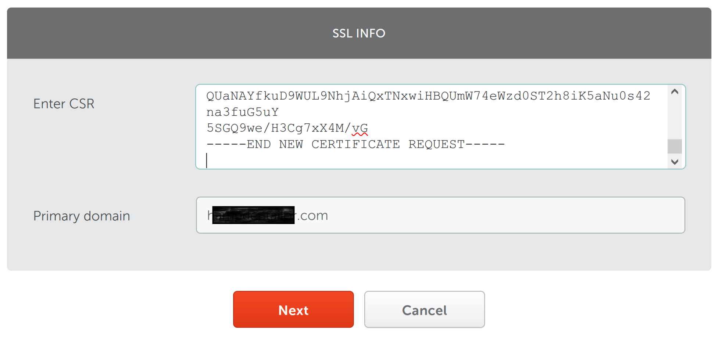
3. Submit the CSR File to NameCheap

Slide 13
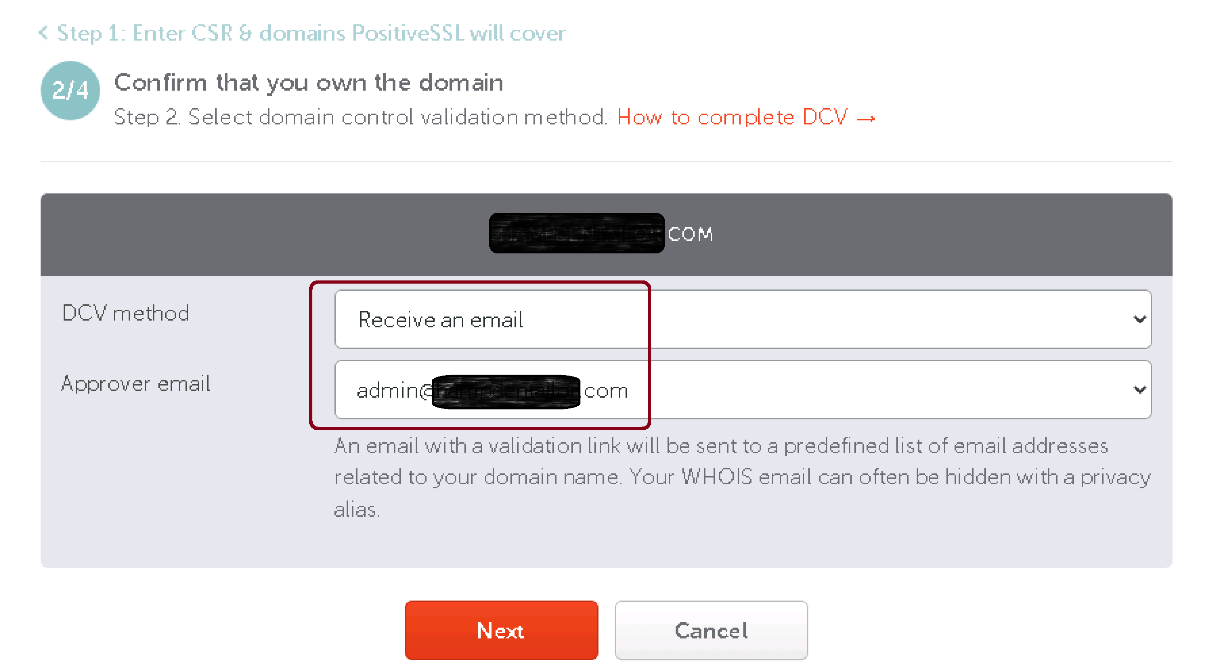
4. Select Domain Control Validation Method

Slide 14
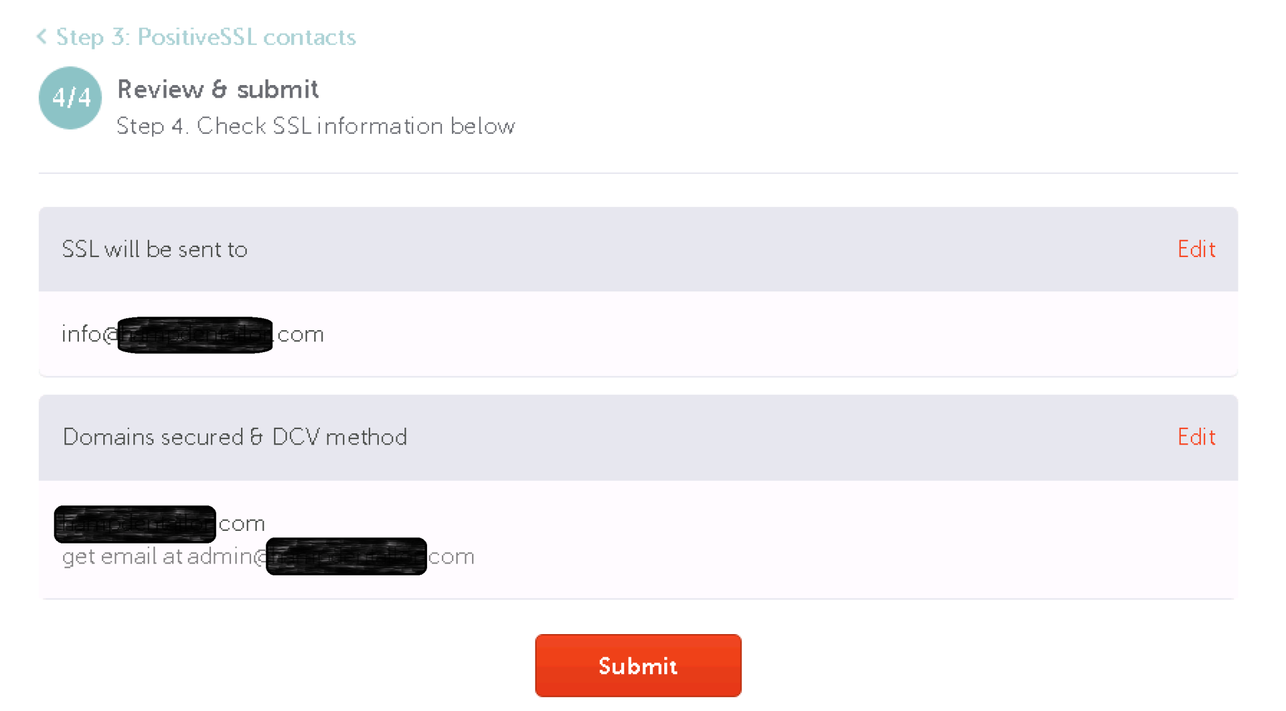
5. Review SSL Information

Slide 15
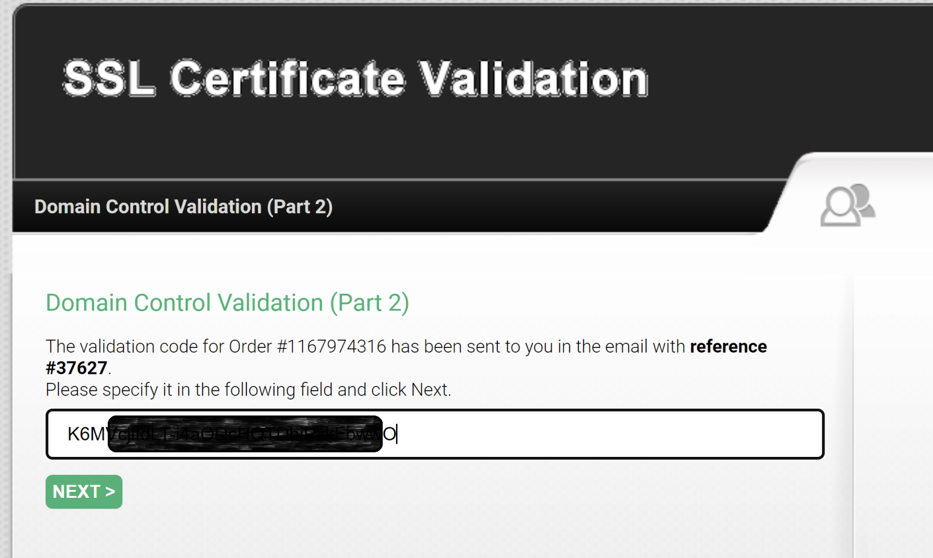
6. Permit the Certificate Issuance
Check email for the link and code

Slide 16
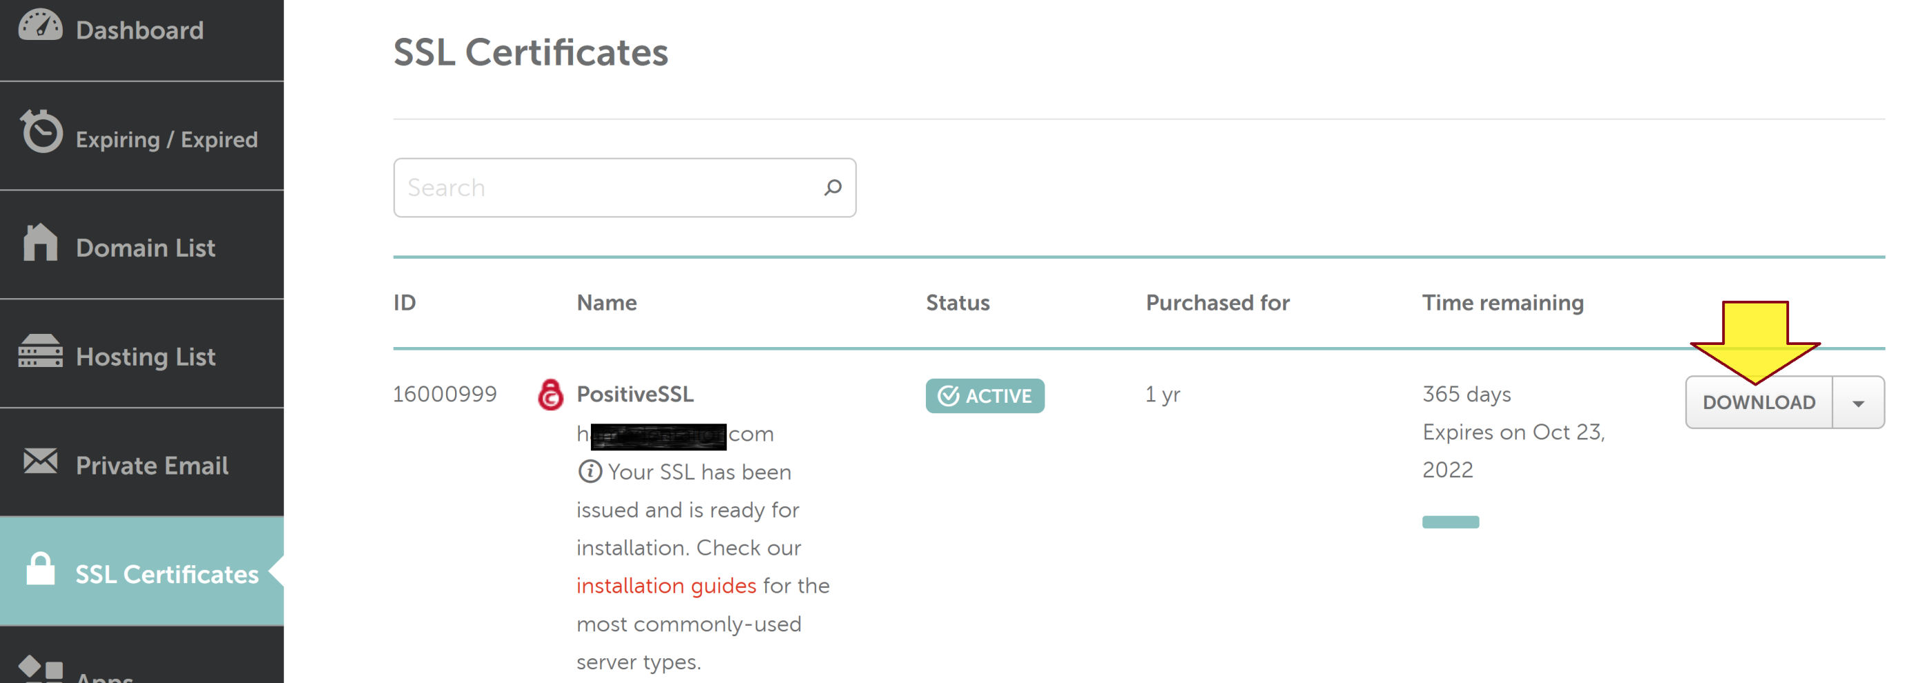
7. Download Certificate

Slide 17
This page intentionally left blank.

Slide 18
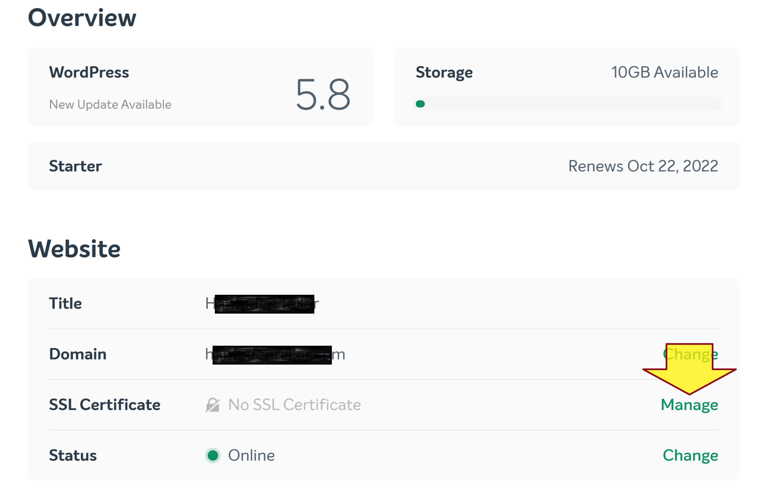
1. Manage SSL Certificate

Slide 19
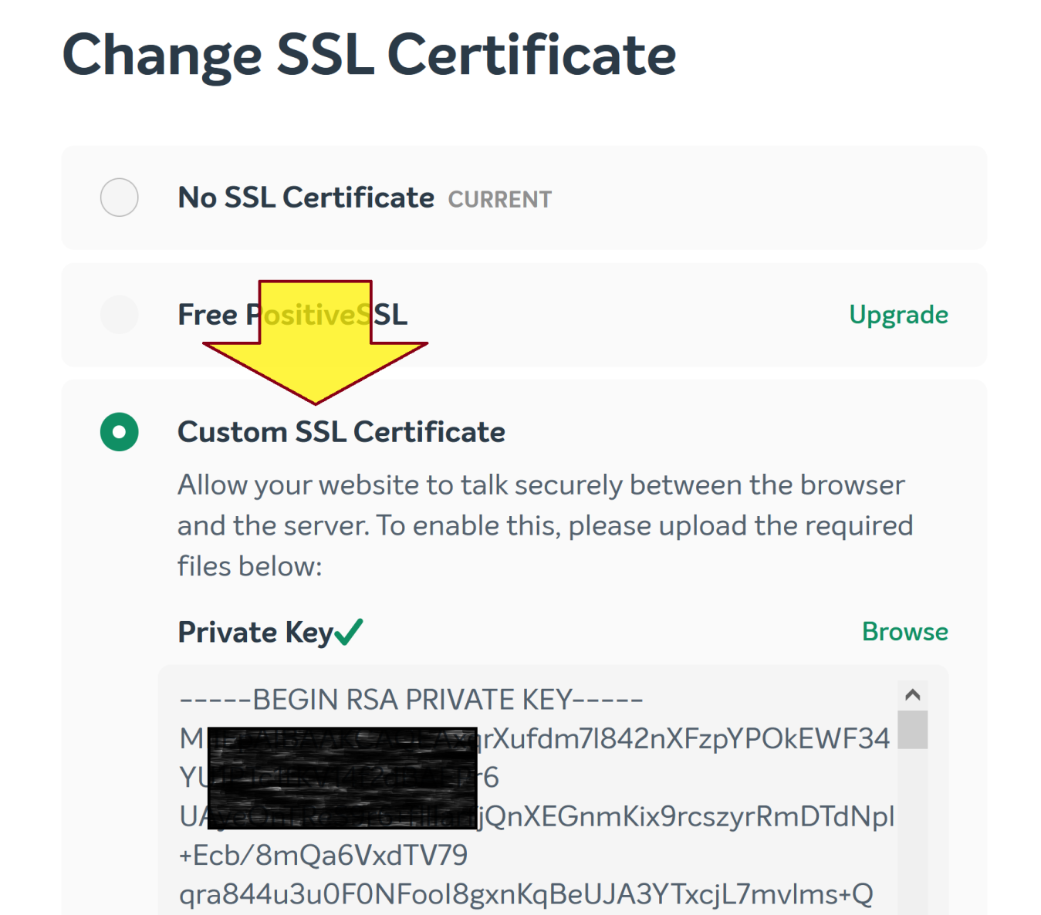
2. Change SSL Certificate

Slide 20

Further Reading

Slide 21

Thank You & See You Again

